Slide 1
IBM x Columbia
Practicum Weekly Meeting
IBM x Columbia Core Team
11/20/2025

Slide 2
AGENDA
1
2
3
4
5
IBM x Columbia
11 / 2025
Why we're here today
Overview
Timeline
Team Check-in
Questions Classification
Next Step

Slide 3
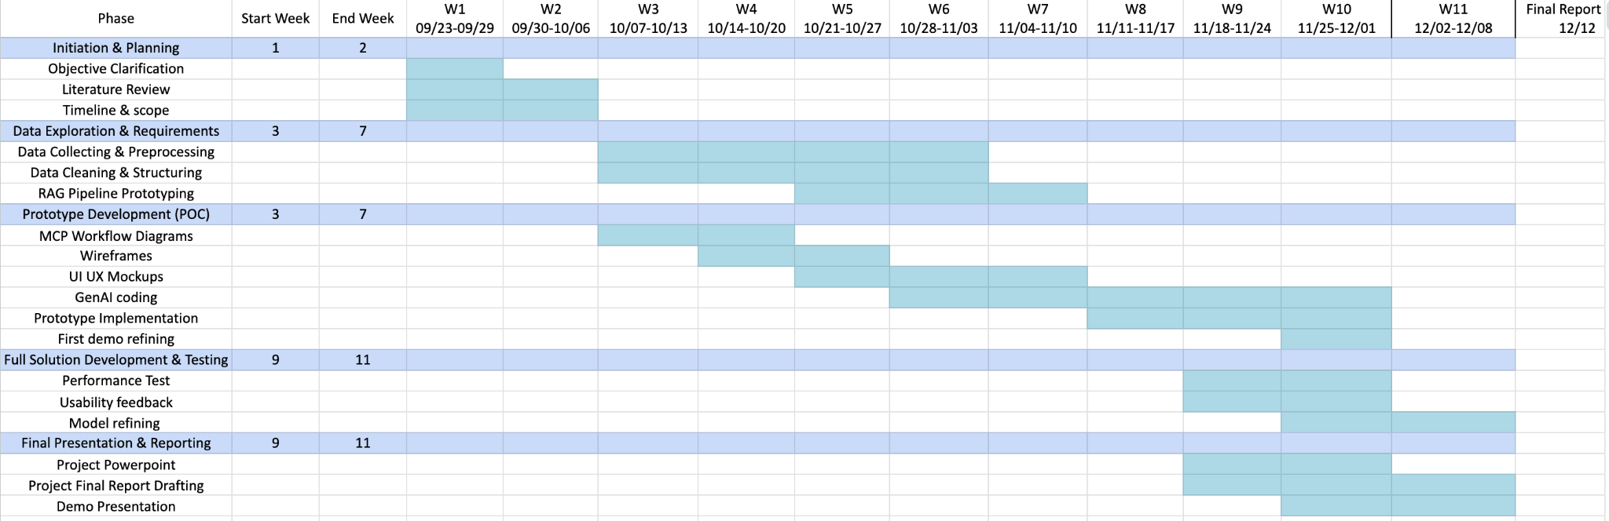
Timeline

Slide 4
Team Check-in
Data & Knowledge Engineering Team
Generative AI & Model Development Team
User Experience & Application Development Team
Evaluation & Compliance Team

Slide 5
Data & Knowledge Engineering Team
Removed some redundant files
4 Phases, 1 EPLC Framework, and 1 HHS EPLC Policy
22 embedding files in total
Next Step:
Provide assistance to the Gen AI and UX team
Embed more policies/templates if needed
Update Readme file

Slide 6
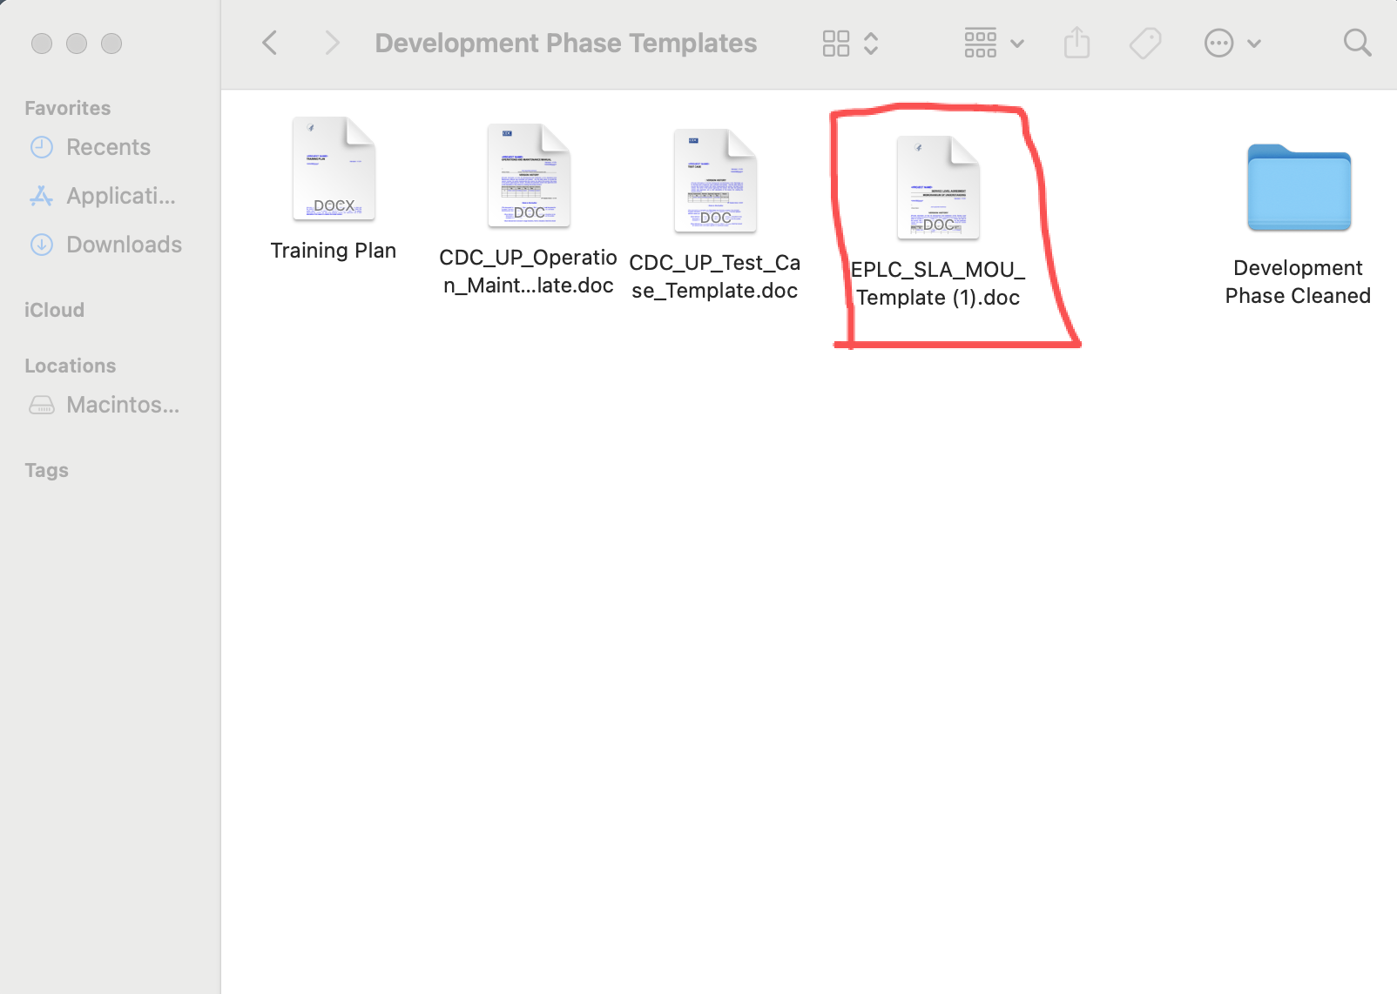
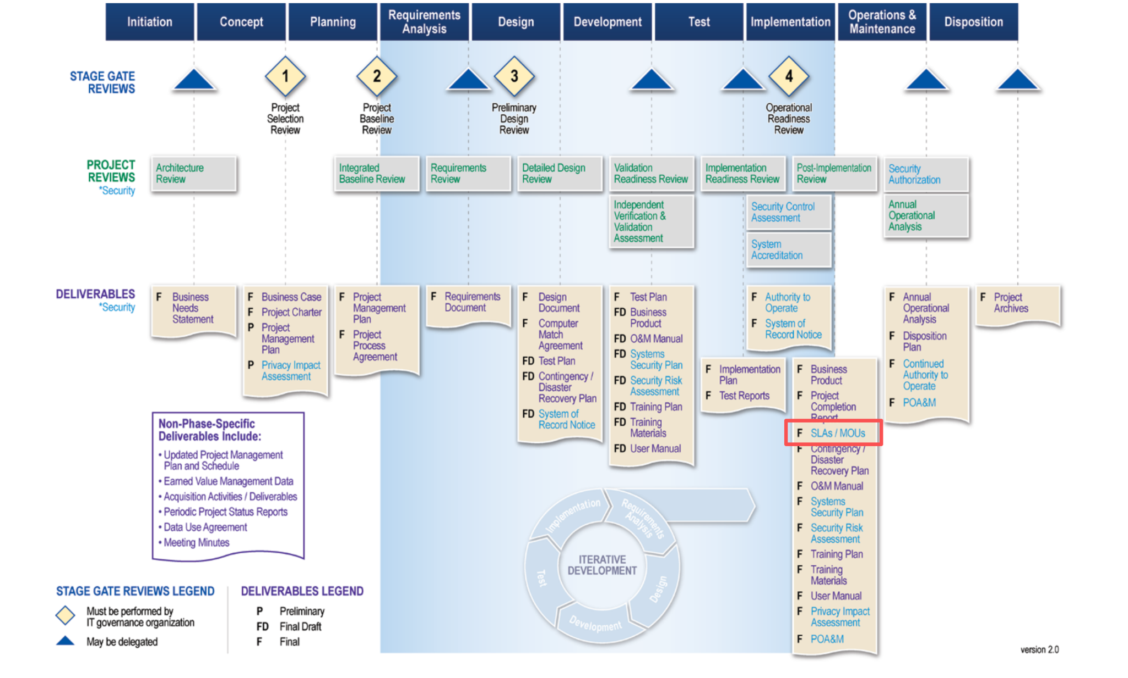
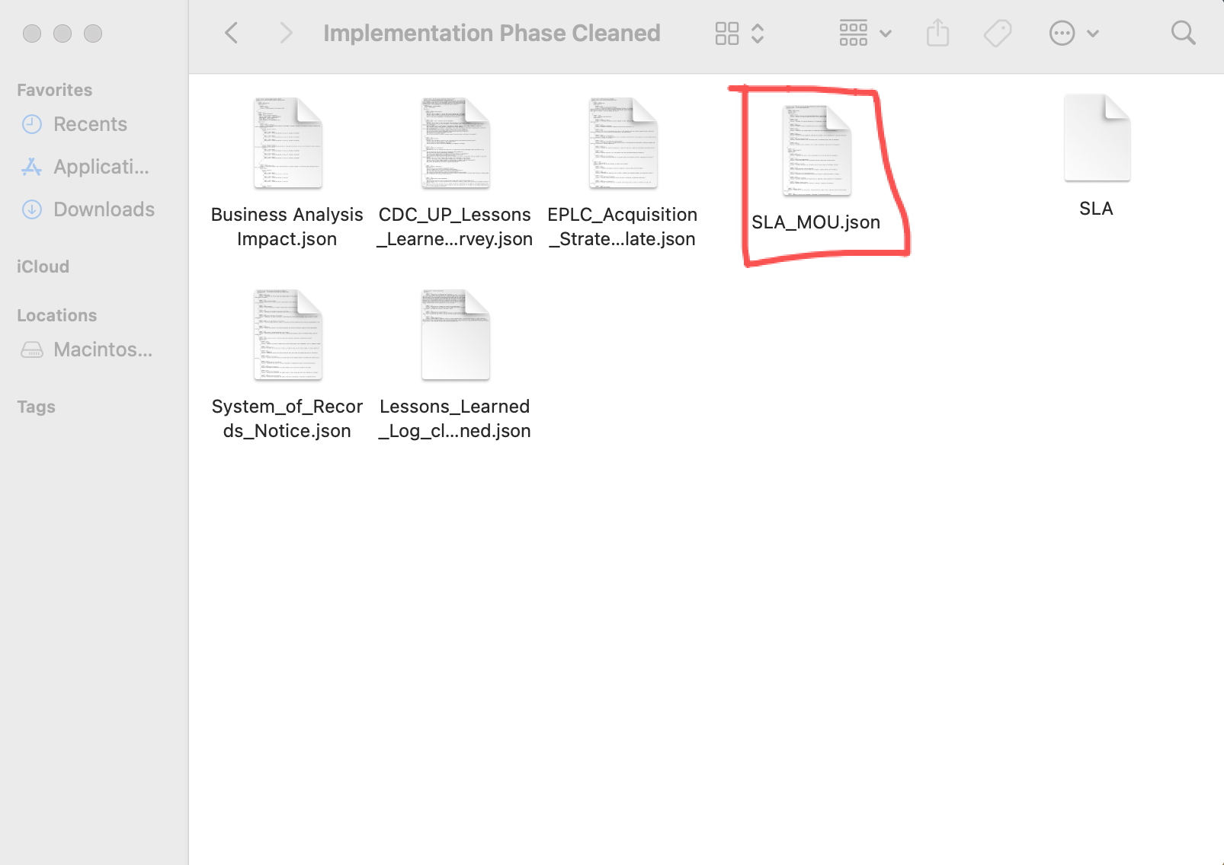
Data & Knowledge Engineering Team

Slide 7
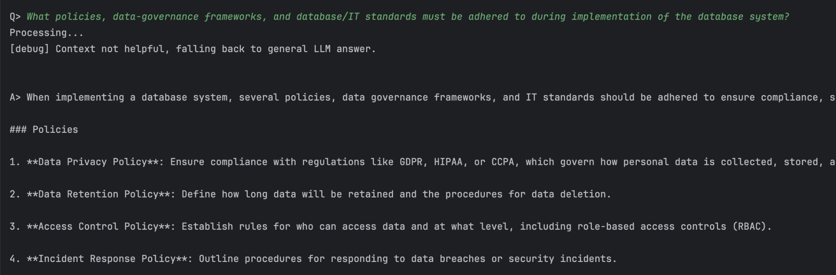
GenAI & Model Development
Updated QnA Coding:

Slide 8
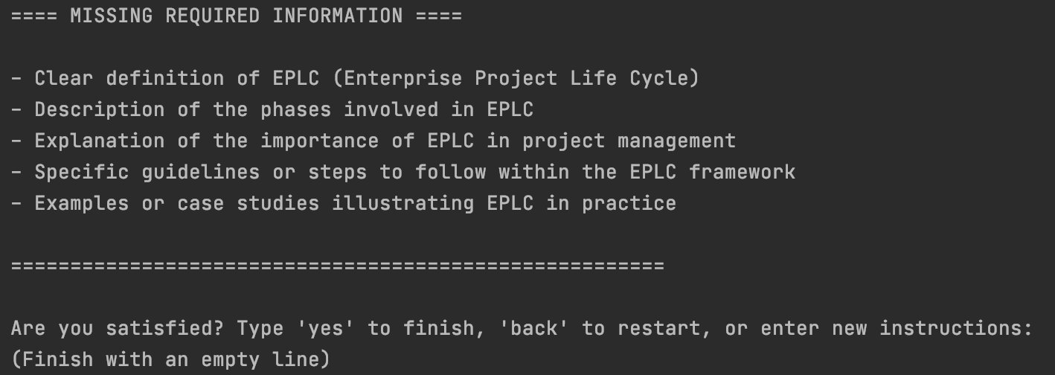
GenAI & Model Development
Updated Generation Coding:
Missing Information & Edit Options:

Slide 9
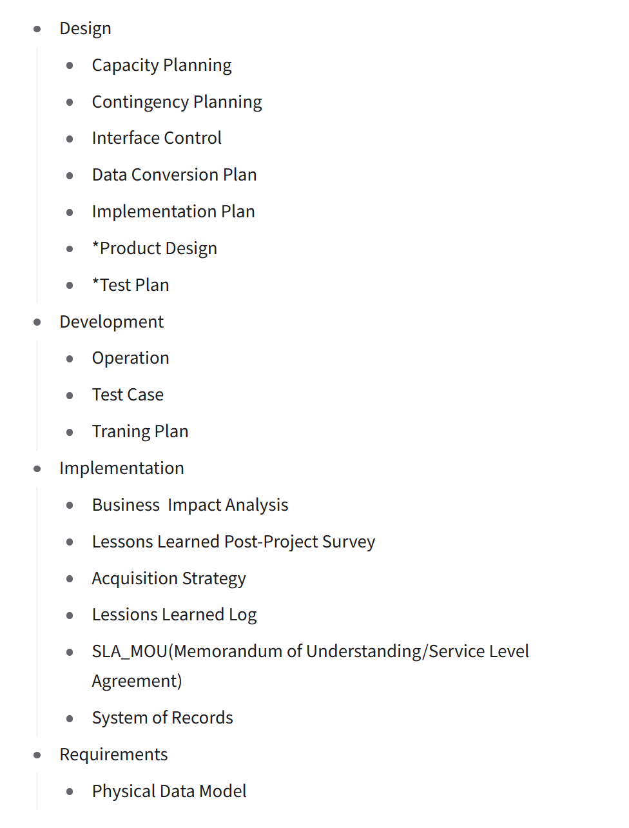
User Experience & Application Development Team
Have integrated the “how to use” & “ask a question” part
For “create a document”,
the phase and document election have been build
the section election part is developing
Planned documents: ->
Total: 17 documents

Slide 10
Evaluation & Compliance Team
Q&A Evaluation https://docs.google.com/spreadsheets/d/13sn4xRfHzt-HkmBl4YlRRr3tA4mY7pnXqNXJYX1sUu0/edit?gid=0#gid=0
We built an evaluation sheet to test the model’s Q&A capability on EPLC-related questions.
It performs well when questions are broad and conceptual such as purpose, phases, and deliverables.
When questions require specific EPLC details, like mandatory artifacts, the model sometimes misses key element.
Next Step:
User case/test case: Extract information from IBM Watsonx
Demo Testing:
Date/Time

Slide 11
Questions

Slide 12
THANK
YOU!
IBM x Columbia
11 / 2025
Columbia Practicum Core Team

